Slide 1
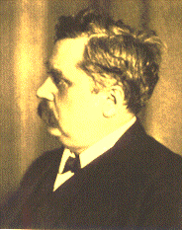
Bonding in coordination compounds
Nobel prize 1913
Alfred Werner - 1893
VBT
Crystal Field Theory (CFT)
Modified CFT, known as Ligand Field Theory
MOT

Slide 2
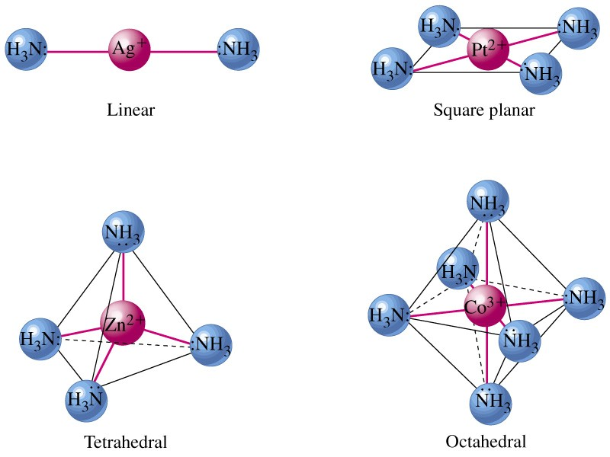
How & Why?

Slide 3
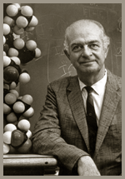
Valance Bond Theory
Basic Principle
A covalent bond forms when the orbtials of two atoms overlap and are occupied by a pair of electrons that have the highest probability of being located between the nuclei.
Linus Carl Pauling
(1901-1994)
Nobel prizes: 1954, 1962

Slide 4
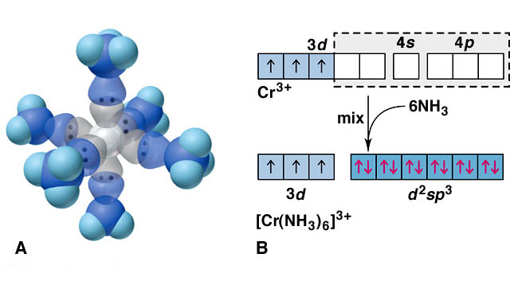
Valance Bond Model
Ligand = Lewis base
Metal = Lewis acid
s, p and d orbitals give hybrid orbitals with specific geometries
Number and type of M-L hybrid orbitals determines geometry of the complex
Octahedral Complex
e.g. [Cr(NH₃)₆]³⁺

Slide 5
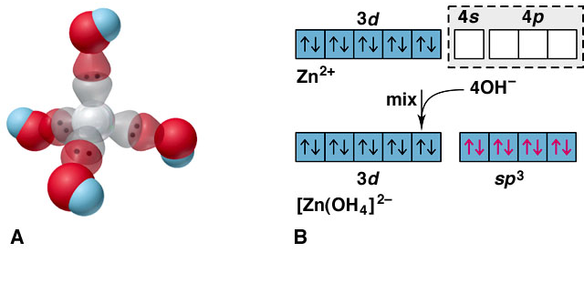
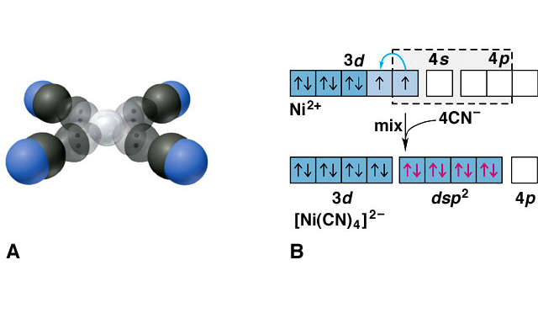
Tetrahedral e.g. [Zn(OH)₄]²⁻
Square Planar e.g. [Ni(CN)₄]²⁻
Limitations of VB theory
Cannot account for colour of complexes
May predict magnetism wrongly
Cannot account for spectrochemical series

Slide 6
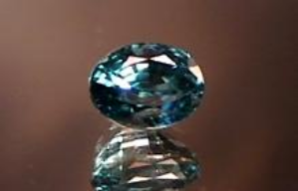
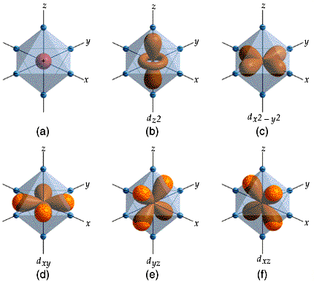
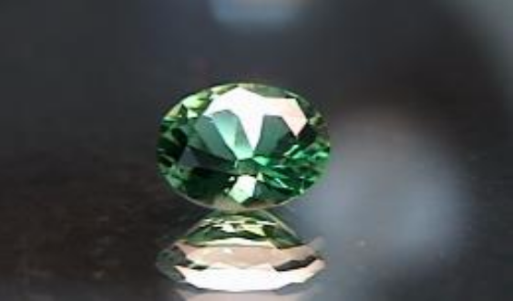
Crystal Field Theory
400
500
600
800
The relationship between colors and complex metal ions

Slide 7
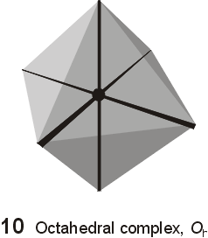
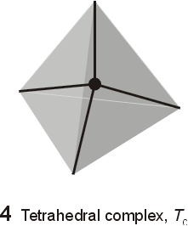
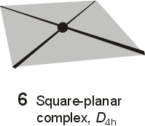
Crystal Field Model
A purely ionic model for transition metal complexes.
Ligands are considered as point charge.
Predicts the pattern of splitting of d-orbitals.
Used to rationalize spectroscopic and magnetic properties.

Slide 8
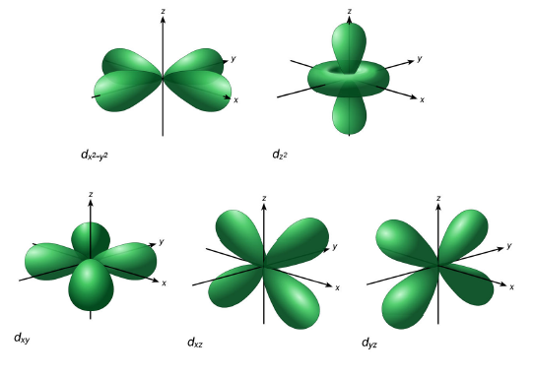
d-orbitals: look attentively along the axis
Linear combination of
d_{z}²-d_{x}² and d_{z}²-d_{y}²
d_{2z}²-_{x}²-_{y}²

Slide 9
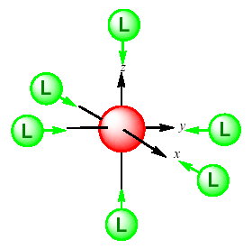
Octahedral Field

Slide 10
We assume an octahedral array of negative charges placed around the metal ion (which is positive).
The ligand and orbitals lie on the same axes as negative charges.
  Therefore, there is a large, unfavorable interaction between ligand (-) and these orbitals.
  These orbitals form the degenerate high energy pair of energy levels.
The d_{xy}, d_{yz}, and d_{xz} orbitals bisect the negative charges.
  Therefore, there is a smaller repulsion between ligand and metal for these orbitals.
  These orbitals form the degenerate low energy set of energy levels.

Slide 11
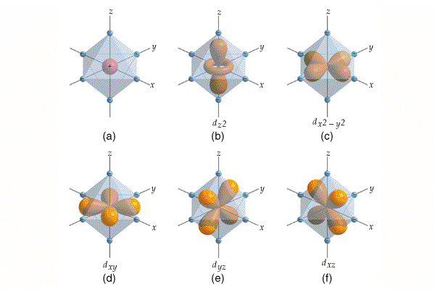

Slide 12
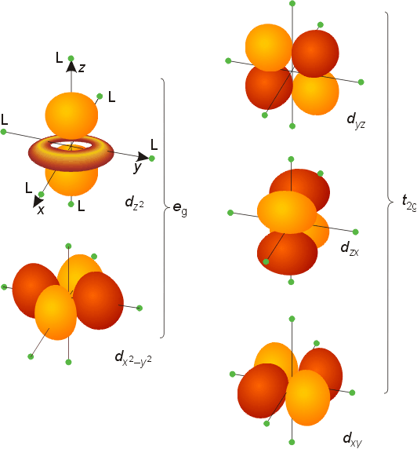
In Octahedral Field
^{d}yz
^{d}z²
^{d}xz
^{d}x²-y²
^{d}xy

Slide 13
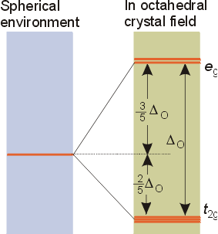
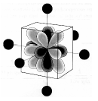

Slide 14
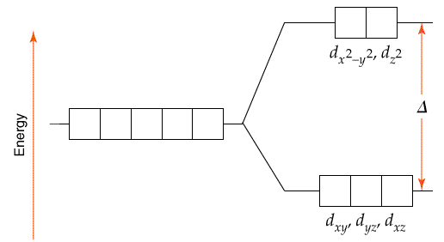
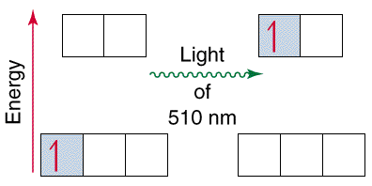

Slide 15
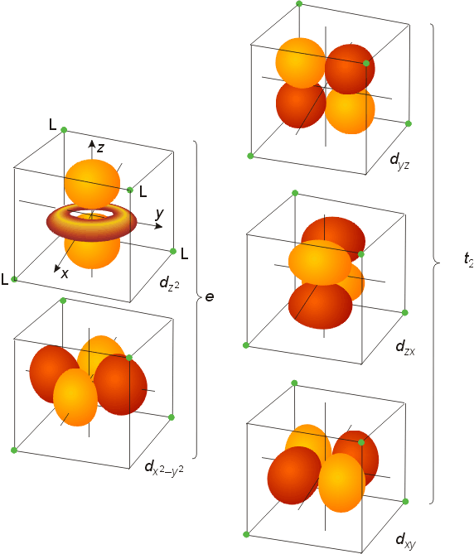
In Tetrahedral Field

Slide 16
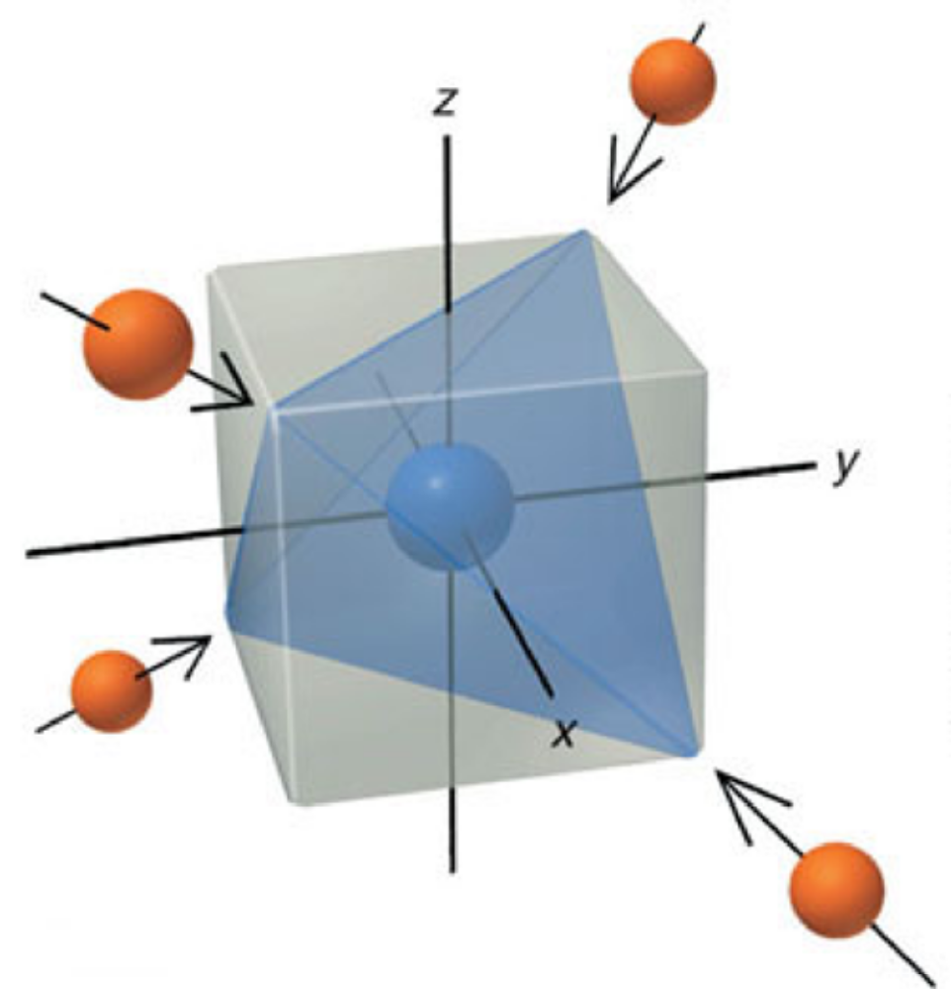

Slide 17
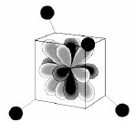
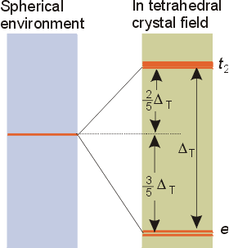

Slide 18
Magnitude of Δ
Oxidation state of the metal ion
[Ru(H₂O)₆]²⁺ 19800 cm⁻¹
[Ru(H₂O)₆]³⁺ 28600 cm⁻¹
Number of ligands and geometry
Δ_{t}< Δ_{o}
Δ_{t}= 4/9Δ_{o}
Nature of the ligand
I⁻<S²⁻<SCN⁻<Cl⁻<NO₃⁻<N₃⁻<F⁻<OH⁻<C₂O₄²⁻<H₂O<…..CN⁻<CO

Slide 19
Crystal Field Splitting Energy (CFSE)
In Octahedral field, configuration is: t_{2g}^{x} e_{g}^{y}
Net energy of the configuration relative to the average energy of the orbitals is:
= (-0.4x + 0.6y)Δ_{O}
Δ_{O} = 10 Dq
BEYOND d³
In weak field: Δ_{O} < P, => t_{2g}³e_{g}¹
In strong field Δ_{O} > P, => t_{2g}⁴
P - paring energy

Slide 20
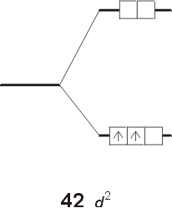
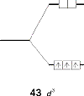
Ground-state Electronic Configuration,
Magnetic Properties and Colour

Slide 21
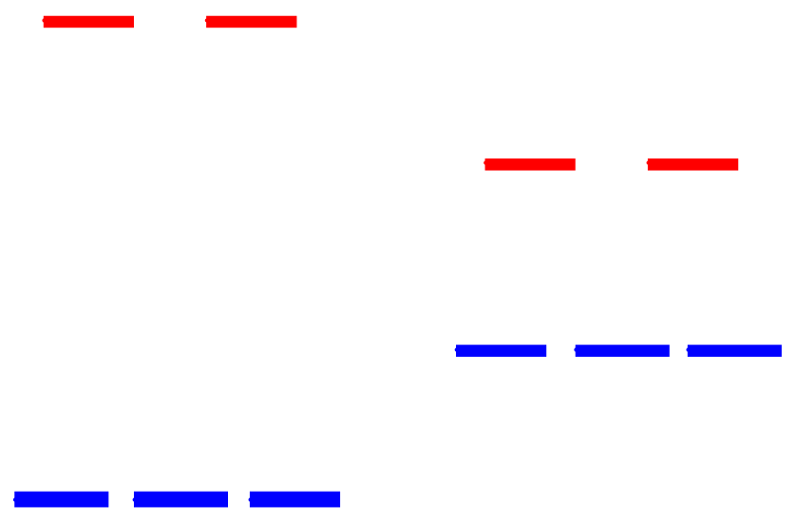
When the 4th electron is assigned it will either go into the higher energy e_{g} orbital at an energy cost of Δ_{o} or be paired at an energy cost of P, the pairing energy.
d⁴
Strong field =
Low spin
(2 unpaired)
Weak field =
High spin
(4 unpaired)
P < Δ_{o}
P > Δ_{o}
Coulombic repulsion energy and exchange energy

Slide 22
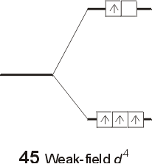
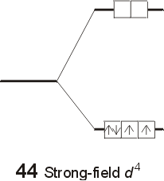
Ground-state Electronic Configuration,
Magnetic Properties and Colour
[Mn(H₂O)₆]³⁺
Weak Field Complex
the total spin is 4 × ½ = 2 High Spin Complex
[Mn(CN)₆]³⁻
Strong field Complex
total spin is 2 × ½ = 1
Low Spin Complex

Slide 23
Placing electrons in d orbitals
d⁵
d⁶
d⁷
1 u.e.
5 u.e.
0 u.e.
4 u.e.
1 u.e.
3 u.e.
d⁸
d⁹
d¹⁰
2 u.e.
2 u.e.
1 u.e.
1 u.e.
0 u.e.
0 u.e.

Slide 24
What is the CFSE of [Fe(CN)₆]³⁻?
CN⁻ = s.f.l.
C.N. = 6 ∴ O_{h}
Fe(III) ∴ d⁵
h.s.
l.s.
3-
e_{g}
e_{g}
+ 0.6 Δ_{oct}
t_{2g}
- 0.4 Δ_{oct}
t_{2g}
CFSE = 5 x - 0.4 Δ_{oct} + 2P =
- 2.0 Δ_{oct} + 2P
If the CFSE of [Co(H₂O)₆]²⁺ is -0.8 Δ_{oct}, what spin state is it in?
C.N. = 6 ∴ O_{h}
Co(II) ∴ d⁷
h.s.
l.s.
2+
e_{g}
e_{g}
+ 0.6 Δ_{oct}
t_{2g}
- 0.4 Δ_{oct}
t_{2g}
CFSE = (5 x - 0.4 Δ_{oct})
+ (2 x 0.6 Δ_{oct}) +2P = - 0.8 Δ_{oct}+2P
CFSE = (6 x - 0.4 Δ_{oct})
+ (0.6 Δ_{oct}) + 3P= - 1.8 Δ_{oct} + P

Slide 25
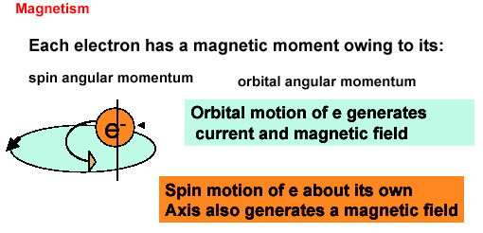

Slide 26
The magnetic moment μ of a complex with total spin quantum number S is:
μ = 2{S(S+1)}^{1/2} μ_{B} (μ_{B} is the Bohr magneton)
μ_{B} = eh/4πm_{e} = 9.274 ×10⁻²⁴ J T⁻¹
Since each unpaired electron has a spin ½,
S = (½)n, where n = no. of unpaired electrons
μ = {n(n+2)}^{1/2} μ_{B}
In d⁴, d⁵, d⁶, and d⁷ octahedral complexes, magnetic measurements can very easily predict weak versus strong field.
Tetrahedral complexes - only high spin complexes result, for Δ_{t} << Δ_{O}.

Slide 27
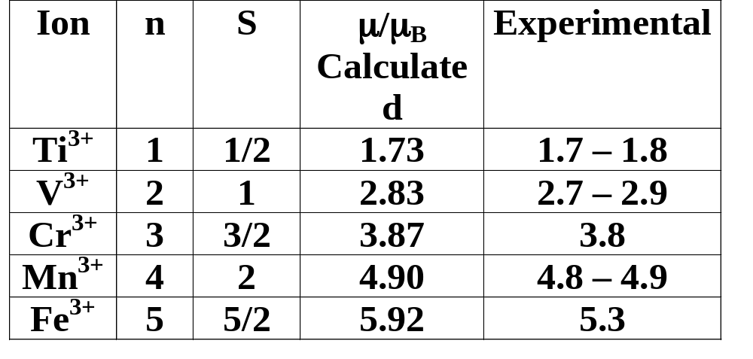
n = no. of unpaired electrons
μ = {n(n+2)}^{1/2} μ_{B}
Similar Calculation can be done
for Low-spin Complex

Slide 28
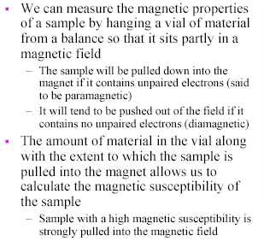
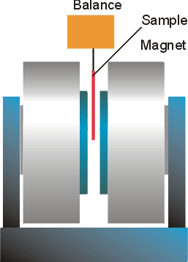
Gouy balance to measure the magnetic susceptibilities

Slide 29
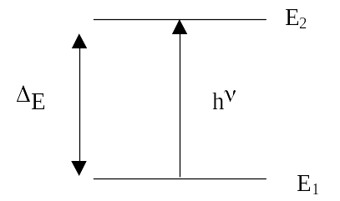

The origin of the color of the transition metal compounds
Ligands influence Δ_{O}, therefore the colour

Slide 30
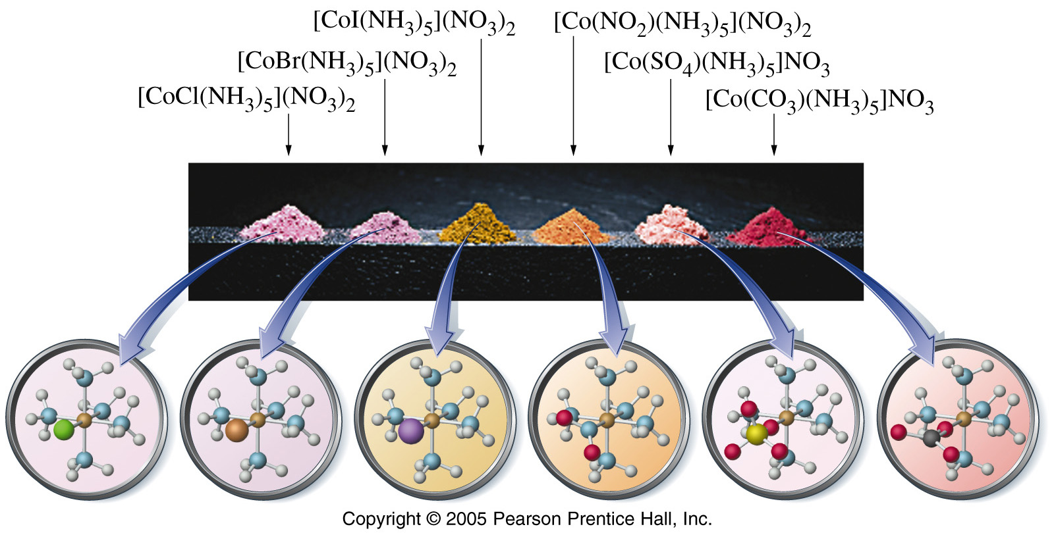
The colour can change depending on a number of factors e.g.
1. Metal charge
2. Ligand strength

Slide 31
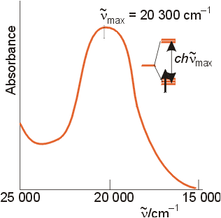
The optical absorption spectrum of [Ti(H₂O)₆]³⁺
Assigned transition: e_{g} t_{2g}
This corresponds to the energy gap
Δ_{O} = 243 kJ mol⁻¹

Slide 32
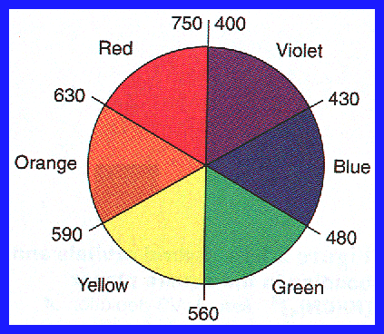
absorbed color
observed color

Slide 33
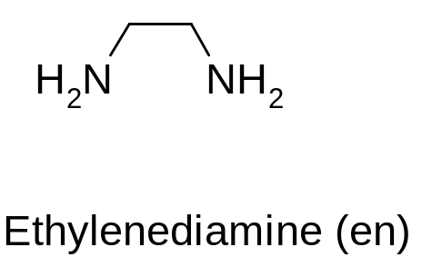
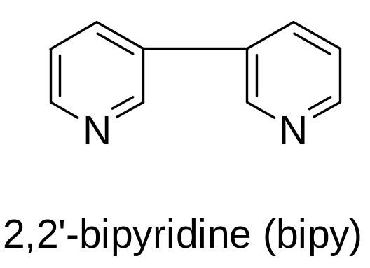
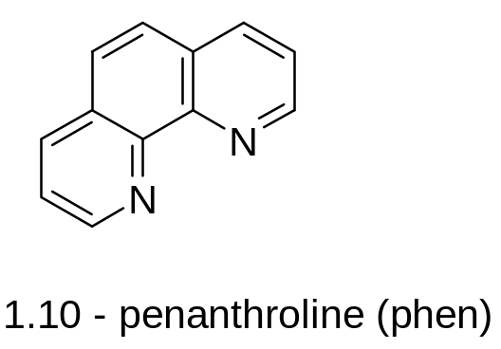
Spectrochemical Series: An order of ligand field strength based on experiment:
Weak Field
I⁻ < Br⁻< S²⁻< SCN⁻< Cl⁻< NO₃⁻< F⁻ < C₂O₄²⁻< H₂O< NCS⁻< CH₃CN< NH₃< en < bipy< phen< NO₂⁻< PPh₃< CN⁻< CO
Strong Field

Slide 34
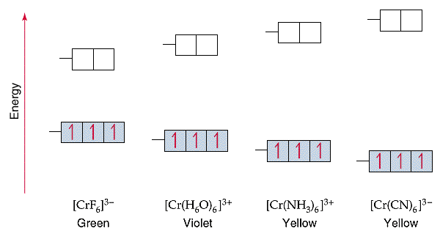
[CrF₆]³⁻
[Cr(H₂O)₆]³⁺
[Cr(NH₃)₆]³⁺
[Cr(CN)₆]³⁻
As Cr³⁺ goes from being attached to a weak field ligand to a strong field ligand, Δ increases and the color of the complex changes from green to yellow.

Slide 35
Limitations of CFT
Considers Ligand as Point charge/dipole only
Does not take into account of the overlap of ligand and metal orbitals
Consequence
e.g. Fails to explain why CO is stronger ligand than CN⁻ in complexes having metal in low oxidation state

Slide 36
Metals in Low Oxidation States
In low oxidation states, the electron density on the metal ion is very high.
To stabilize low oxidation states, we require ligands, which can simultaneously bind the metal center and also withdraw electron density from it.

Slide 37
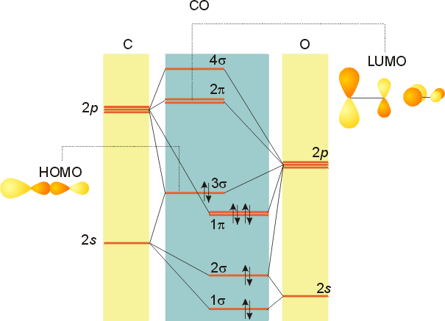
Stabilizing Low Oxidation State: CO Can Do the Job

Slide 38
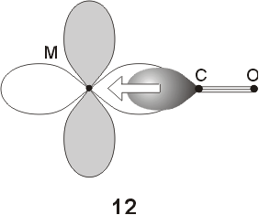
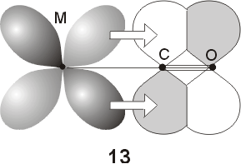
Stabilizing Low Oxidation State: CO Can Do the Job
Ni(CO)₄], [Fe(CO)₅], [Cr(CO)₆], [Mn₂(CO)₁₀], [Co₂(CO)₈], Na₂[Fe(CO)₄], Na[Mn(CO)₅]

Slide 39
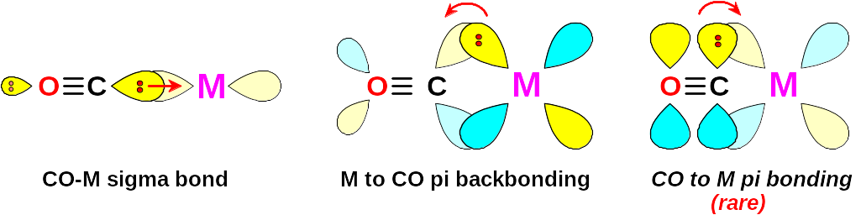
O
C
M
σ orbital serves as a very weak donor to a metal atom

